Slide 1
Complex Number
Nazmul Kader Chowdhury

Slide 2
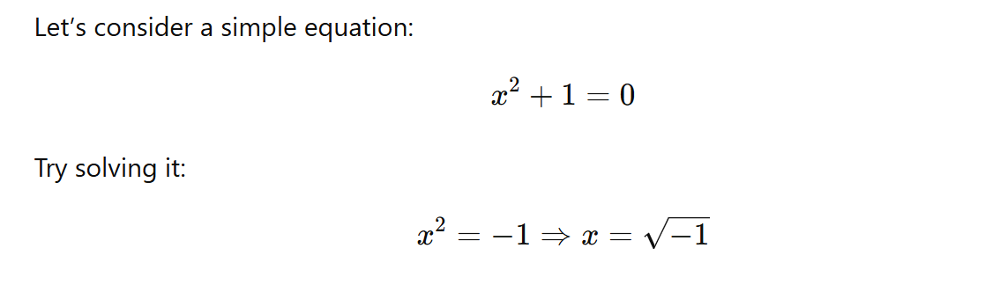
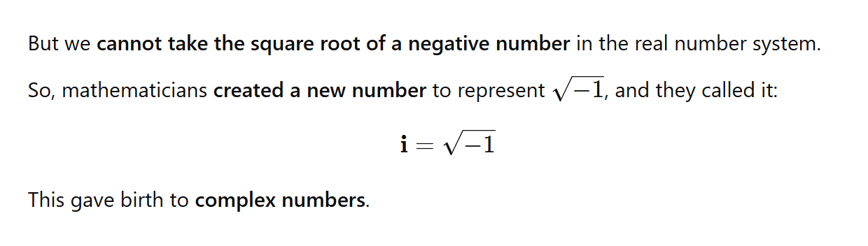
Why Were Complex Numbers Invented?

Slide 3
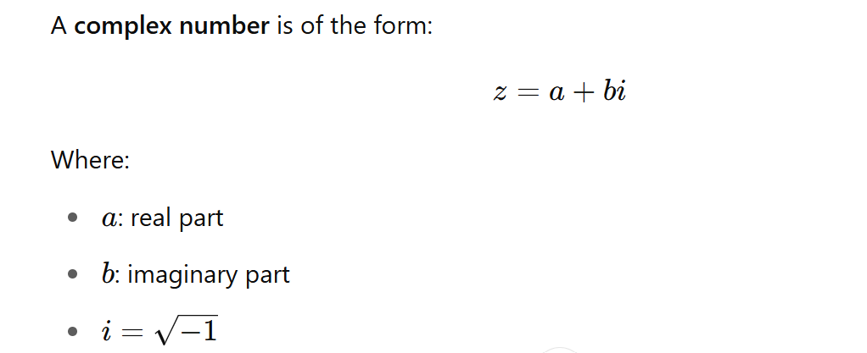
Definition of a Complex Number

Slide 4
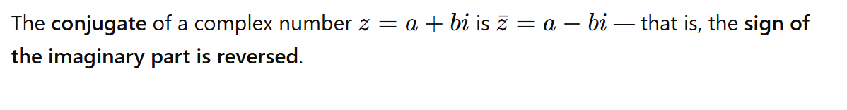
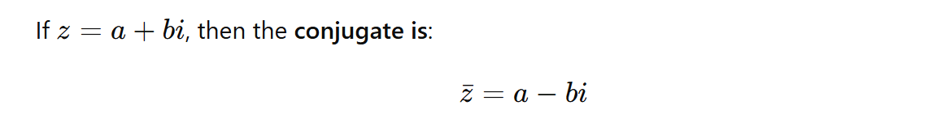
What is the Conjugate of a Complex Number?

Slide 5
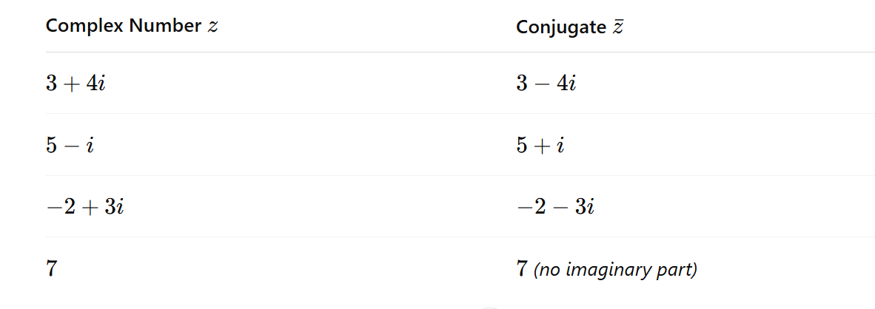

Slide 6
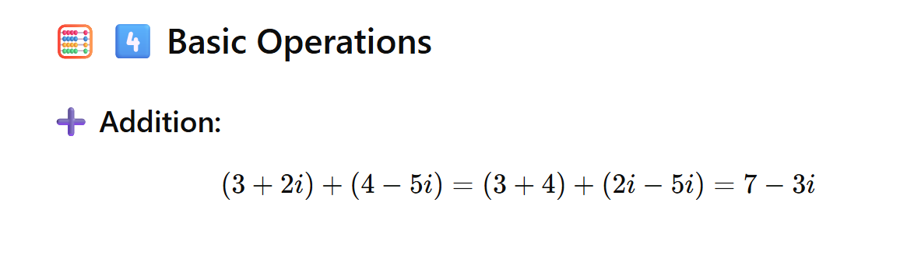
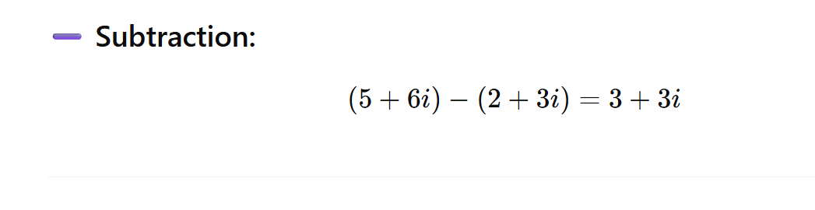

Slide 7
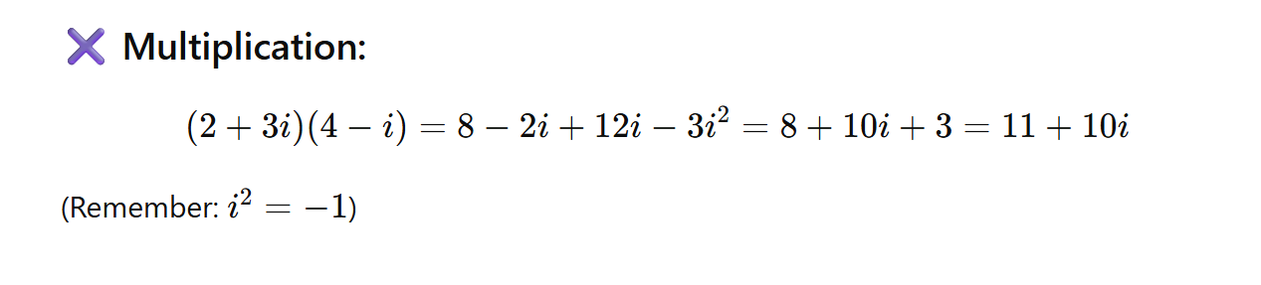
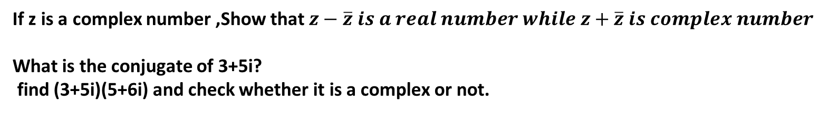
If z is a complex number ,Show that $z−\overline{z} is a real number while z+\overline{z} is complex number$
What is the conjugate of 3+5i?
find (3+5i)(5+6i) and check whether it is a complex or not.

